Slide 1
Dispersion Using SPSS Output
Hours watching TV for Soc 3155 students:
What is the range & interquartile range?
Is there skew (positive or negative) in this distribution?
What is the most common number of hours reported?
What is the average squared distance that cases deviate from the mean?
Statistics
Hours watch TV in typical week
N Valid 18 Missing 11
Mean 8.2778
Median 5.0000
Mode 5.00
Std. Deviation 7.97648
Variance 63.624
Minimum 1.00
Maximum 28.00
Percentiles
25 3.0000
50 5.0000
75 14.0000

Slide 2
Hypothesis practice
For each, write the null hypothesis and indicate whether it is directional
Crime rates are related to unemployment rates
People with lumpy heads are less likely to shave their hair off
There is a difference in criminal behavior between those who live with parents and those who do not
Those with prior felony offenses will be more likely to commit new crimes than those without prior offenses

Slide 3
The Normal Curve & Z Scores
Notes:
[

Slide 4
THE NORMAL CURVE
Characteristics:
Theoretical distribution of scores
Perfectly symmetrical
Bell-shaped
Unimodal
Tails extend infinitely in both directions
Y
axis
x AXIS

Slide 5
THE NORMAL CURVE
Assumption of normality of a given empirical distribution makes it possible to describe this “real-world” distribution based on what we know about the (theoretical) normal curve

Slide 6
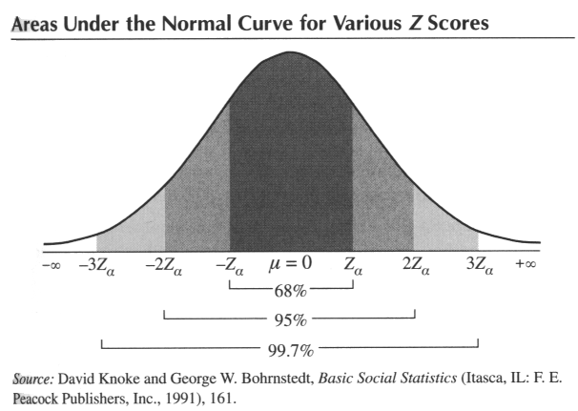
THE NORMAL CURVE
.68 of area under the curve (.34 on each side of mean) falls within 1 standard deviation (s) of the mean
In other words, 68% of cases fall within +/- 1 s
95% of cases fall within 2 s’s
99% of cases fall within 3 s’s

Slide 7
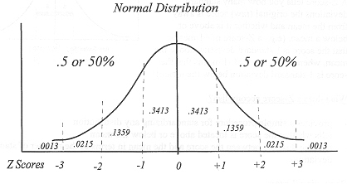
Areas Under the Normal Curve
Because the normal curve is symmetrical, we know that 50% of its area falls on either side of the mean.
FOR EACH SIDE:
34.13% of scores in distribution are b/t the mean and 1 s from the mean
13.59% of scores are between 1 and 2 s’s from the mean
2.28% of scores are > 2 s’s from the mean

Slide 8
THE NORMAL CURVE
Example:
Male height = normally distributed, mean = 70 inches, s = 4 inches
What is the range of heights that encompasses 99% of the population?
Hint: that’s +/- 3 standard deviations

Slide 9
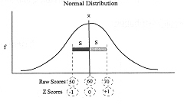
THE NORMAL CURVE & Z SCORES
To use the normal curve to answer questions, raw scores of a distribution must be transformed into Z scores
Z scores:
Formula: Z_{i} = X_{i} – X
s
A tool to help determine how a given score measures up to the whole distribution
RAW SCORES: 66 70 74
Z SCORES: -1 0 1

Slide 10
NORMAL CURVE & Z SCORES
Transforming raw scores to Z scores
a.k.a. “standardizing”
converts all values of variables to a new scale:
mean = 0
standard deviation = 1
Converting raw scores to Z scores makes it easy to compare 2+ variables
Z scores also allow us to find areas under the theoretical normal curve

Slide 11
Z SCORE FORMULA Z = X_{i} – X S
X_{i} = 120; X = 100; s=10
Z= 120 – 100 = +2.00
10
X_{i} = 80, S = 10
X_{i} = 112, S = 10
X_{i} = 95; X = 86; s=7
Z= 80 – 100 = -2.00
10
Z = 112 – 100 = 1.20
10
Z= 95 – 86 = 1.29
7

Slide 12
USING Z SCORES FOR COMPARISONS
Example 1:
An outdoor magazine does an analysis that assigns separate scores for states’ “quality of hunting” (MN = 81) & “quality of fishing” (MN =74). Based on the following information, which score is higher relative to other states?
Formula: Z_{i} = X_{i} – X
s
Quality of hunting for all states: X = 69, s = 8
Quality of fishing for all states: X = 65, s = 5

Slide 13
USING Z SCORES FOR COMPARISONS
Example 2:
You score 80 on a Sociology exam & 68 on a Philosophy exam. On which test did you do better relative to other students in each class?
Formula: Z_{i} = X_{i} – X
s
Sociology: X = 83, s = 10
Philosophy: X = 62, s = 6

Slide 14
Normal curve table
For any standardized normal distribution, Appendix A (p. 453-456) of Healey provides precise info on:
the area between the mean and the Z score (column b)
the area beyond Z (column c)
Table reports absolute values of Z scores
Can be used to find:
The total area above or below a Z score
The total area between 2 Z scores

Slide 15
THE NORMAL DISTRIBUTION
Area above or below a Z score
If we know how many S.D.s away from the mean a score is, assuming a normal distribution, we know what % of scores falls above or below that score
This info can be used to calculate percentiles

Slide 16
AREA BELOW Z
EXAMPLE 1: You get a 58 on a Sociology test. You learn that the mean score was 50 and the S.D. was 10.
What % of scores was below yours?
Z_{i} = X_{i} – X = 58 – 50 = 0.8
s 10

Slide 17
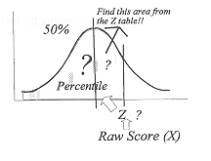
AREA BELOW Z
What % of scores was below yours?
Z_{i} = X_{i} – X = 58 – 50 = 0.8
s 10
Appendix A, Column B -- .2881 (28.81%) of area of normal curve falls between mean and a Z score of 0.8
Because your score (58) > the mean (50), remember to add .50 (50%) to the above value
.50 (area below mean) + .2881 (area b/t mean & Z score) = .7881 (78.81% of scores were below yours)
YOUR SCORE WAS IN THE 79TH PERCENTILE
FIND THIS AREA
FROM COLUMN B

Slide 18
AREA BELOW Z
Example 2:
Your friend gets a 44 (mean = 50 & s=10) on the same test
What % of scores was below his?

Slide 19
AREA BELOW Z
What % of scores was below his?
Z = X_{i} – X = 44 – 50= -0.6
s 10
FIND THIS AREA
FROM COLUMN C

Slide 20
Z SCORES: “ABOVE” EXAMPLE
Sometimes, lower is better…
Example: If you shot a 68 in golf (mean=73.5, s = 4), how many scores are above yours?
68 – 73.5 = - 1.37
4
68 73.5
FIND THIS AREA FROM COLUMN B

Slide 21
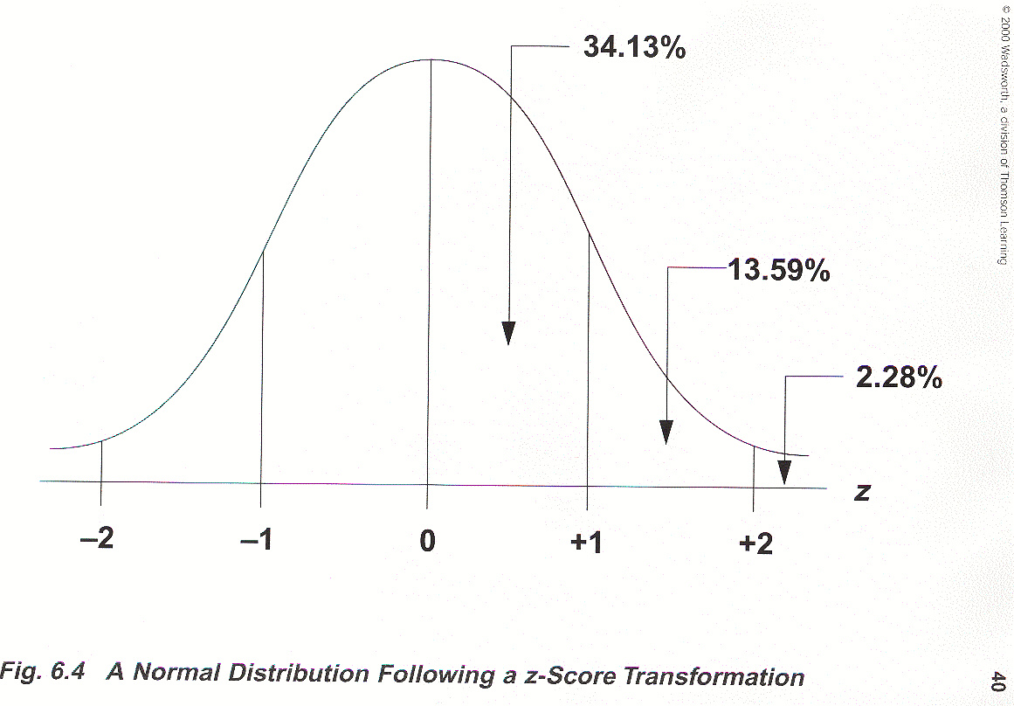
Area between 2 Z Scores
What percentage of people have I.Q. scores between Stan’s score of 110 and Shelly’s score of 125? (mean = 100, s = 15)
CALCULATE Z SCORES

Slide 22
AREA BETWEEN 2 Z SCORES
EXAMPLE 2:
The mean prison admission rate for U.S. counties is 385 per 100k, with a standard deviation of 151 (approx. normal distribution)
Given this information, what percentage of counties fall between counties A (220 per 100k) & B (450 per 100k)?

Slide 23
4 More Sample Problems
For a sample of 150 U.S. cities, the mean poverty rate (per 100) is 12.5 with a standard deviation of 4.0. The distribution is approximately normal.
Based on the above information:
What percent of cities had a poverty rate of more than 8.5 per 100?
What percent of cities had a rate between 13.0 and 16.5?
What percent of cities had a rate between 10.5 and 14.3?
What percent of cities had a rate between 8.5 and 10.5?

